Slide 1
Rekayasa Piranti Lunak
#10
UML Diagrams

Slide 2
Today
UML
Use Case Diagram - review
Class Diagram Activity Diagram - review
Sequence Diagram

Slide 3
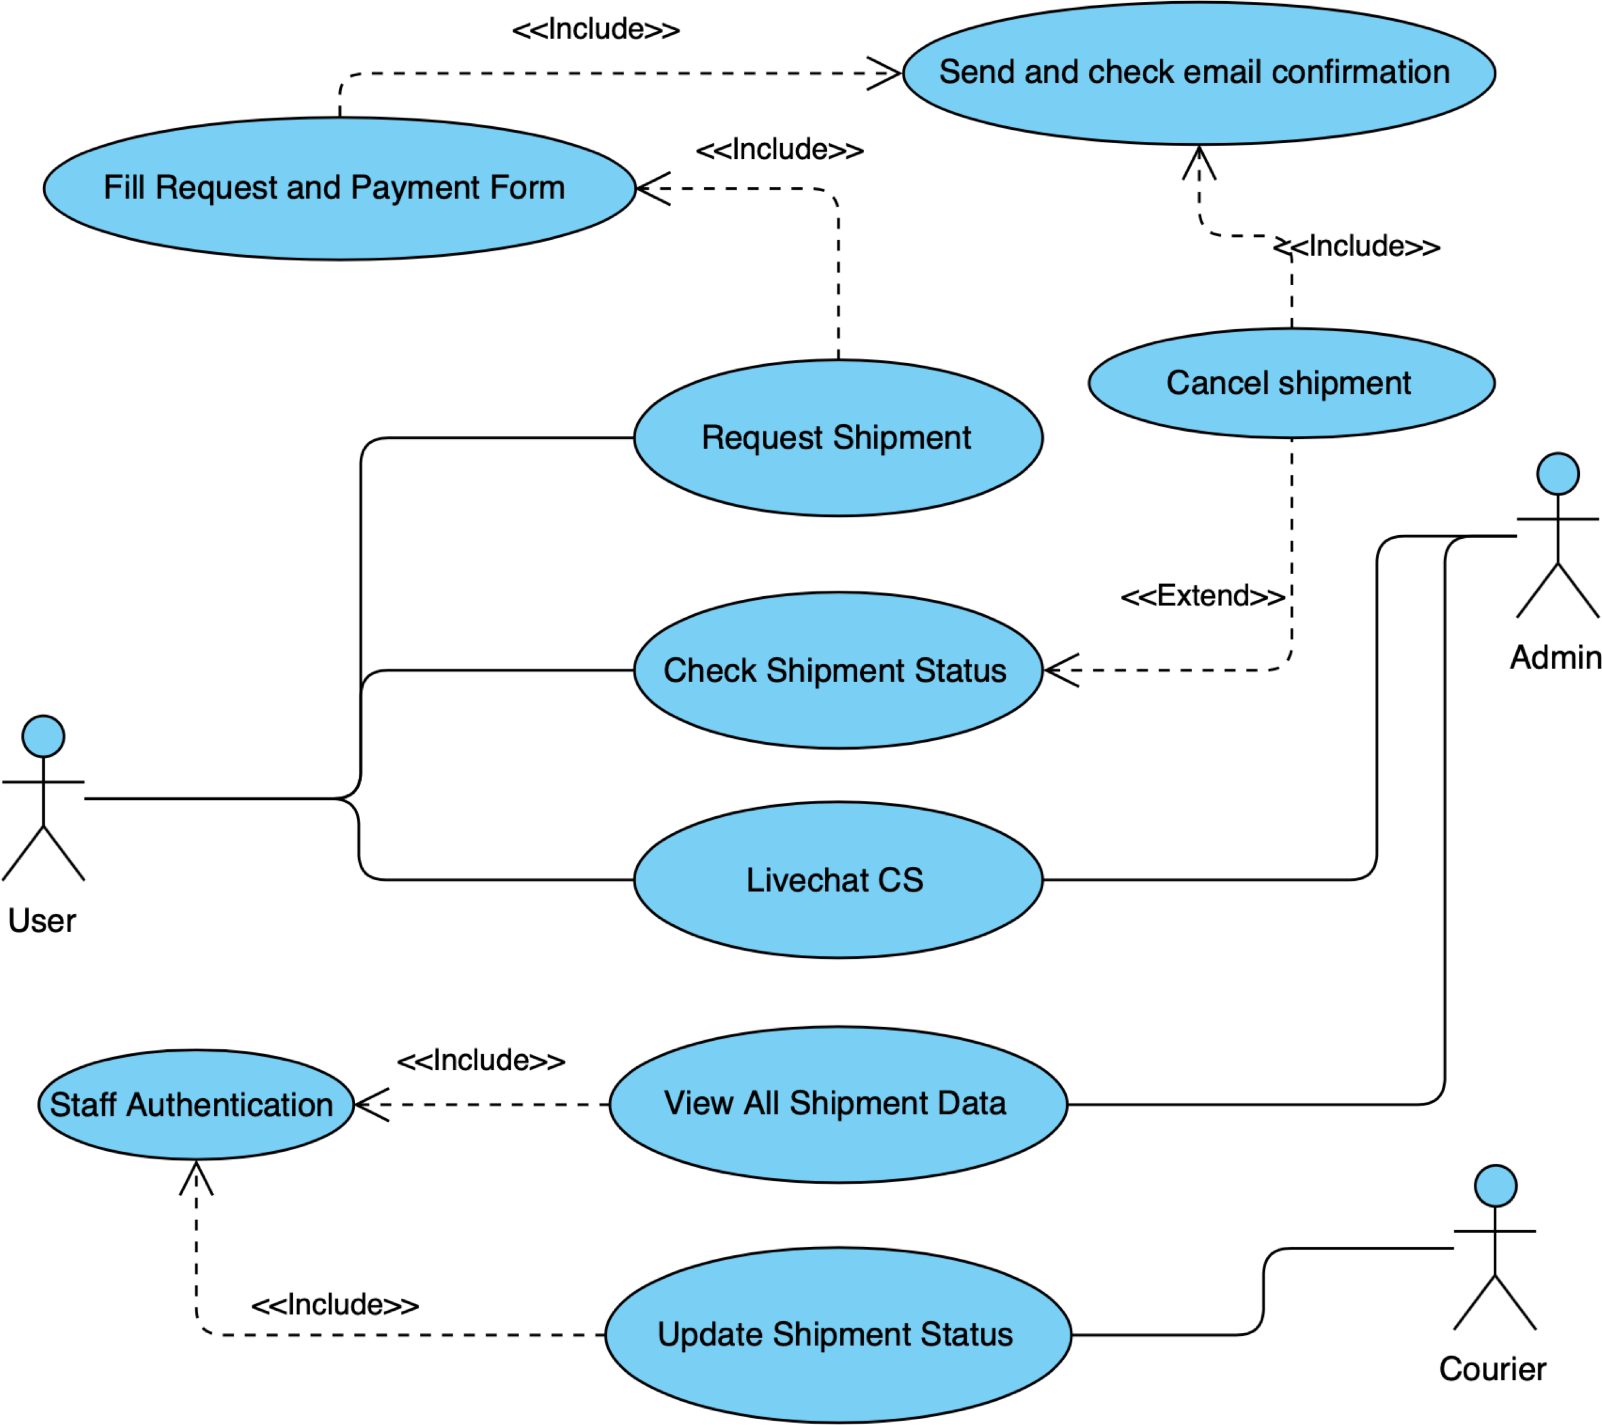

Slide 4
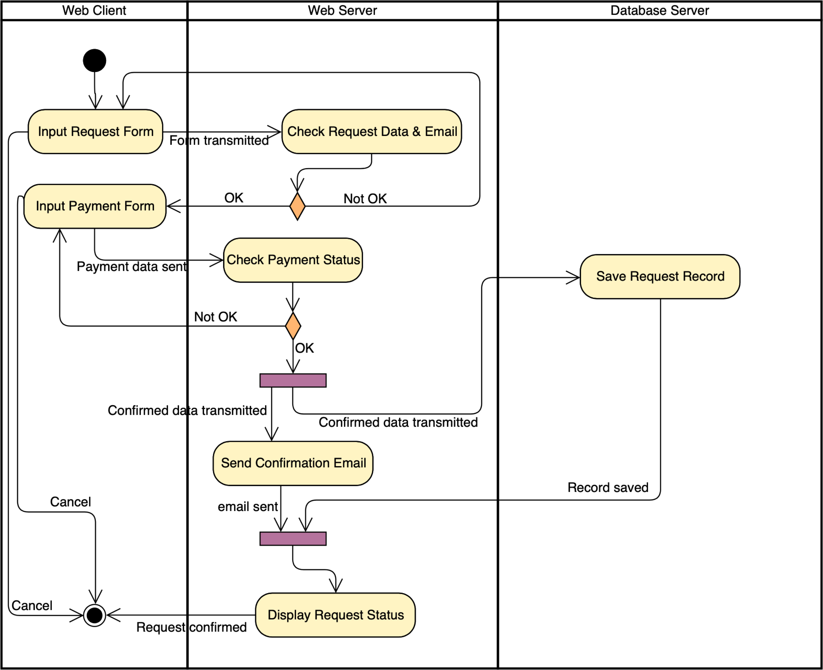
Request Shipment

Slide 5
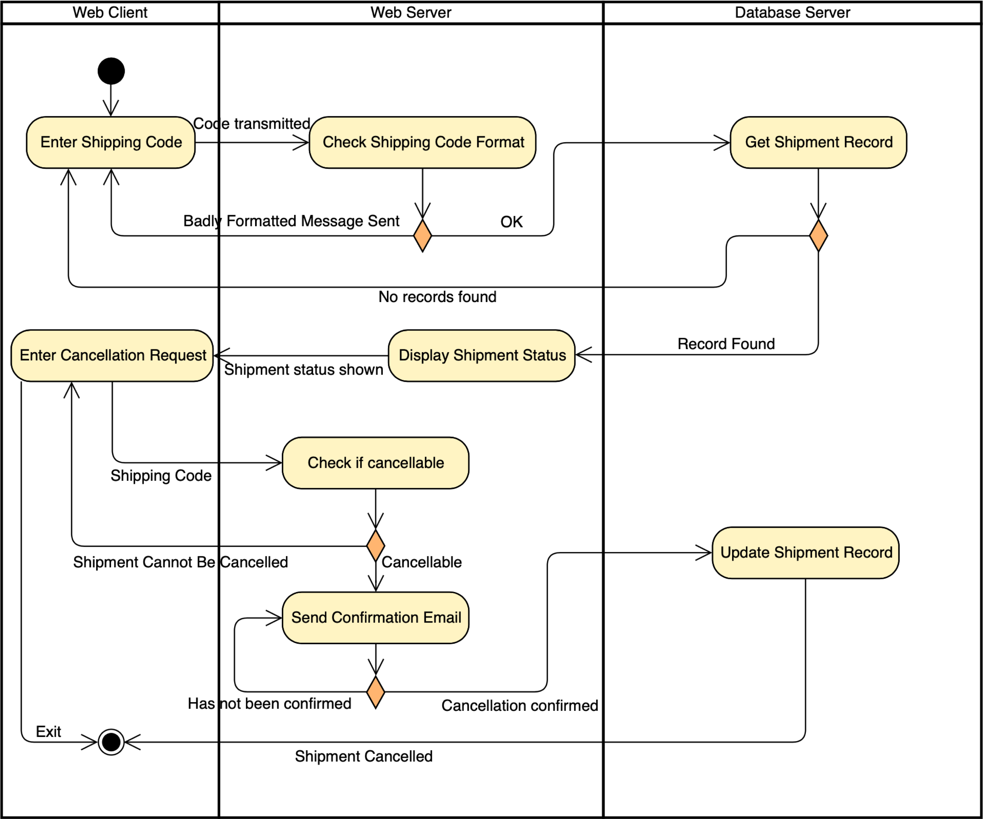
Check Status

Slide 6
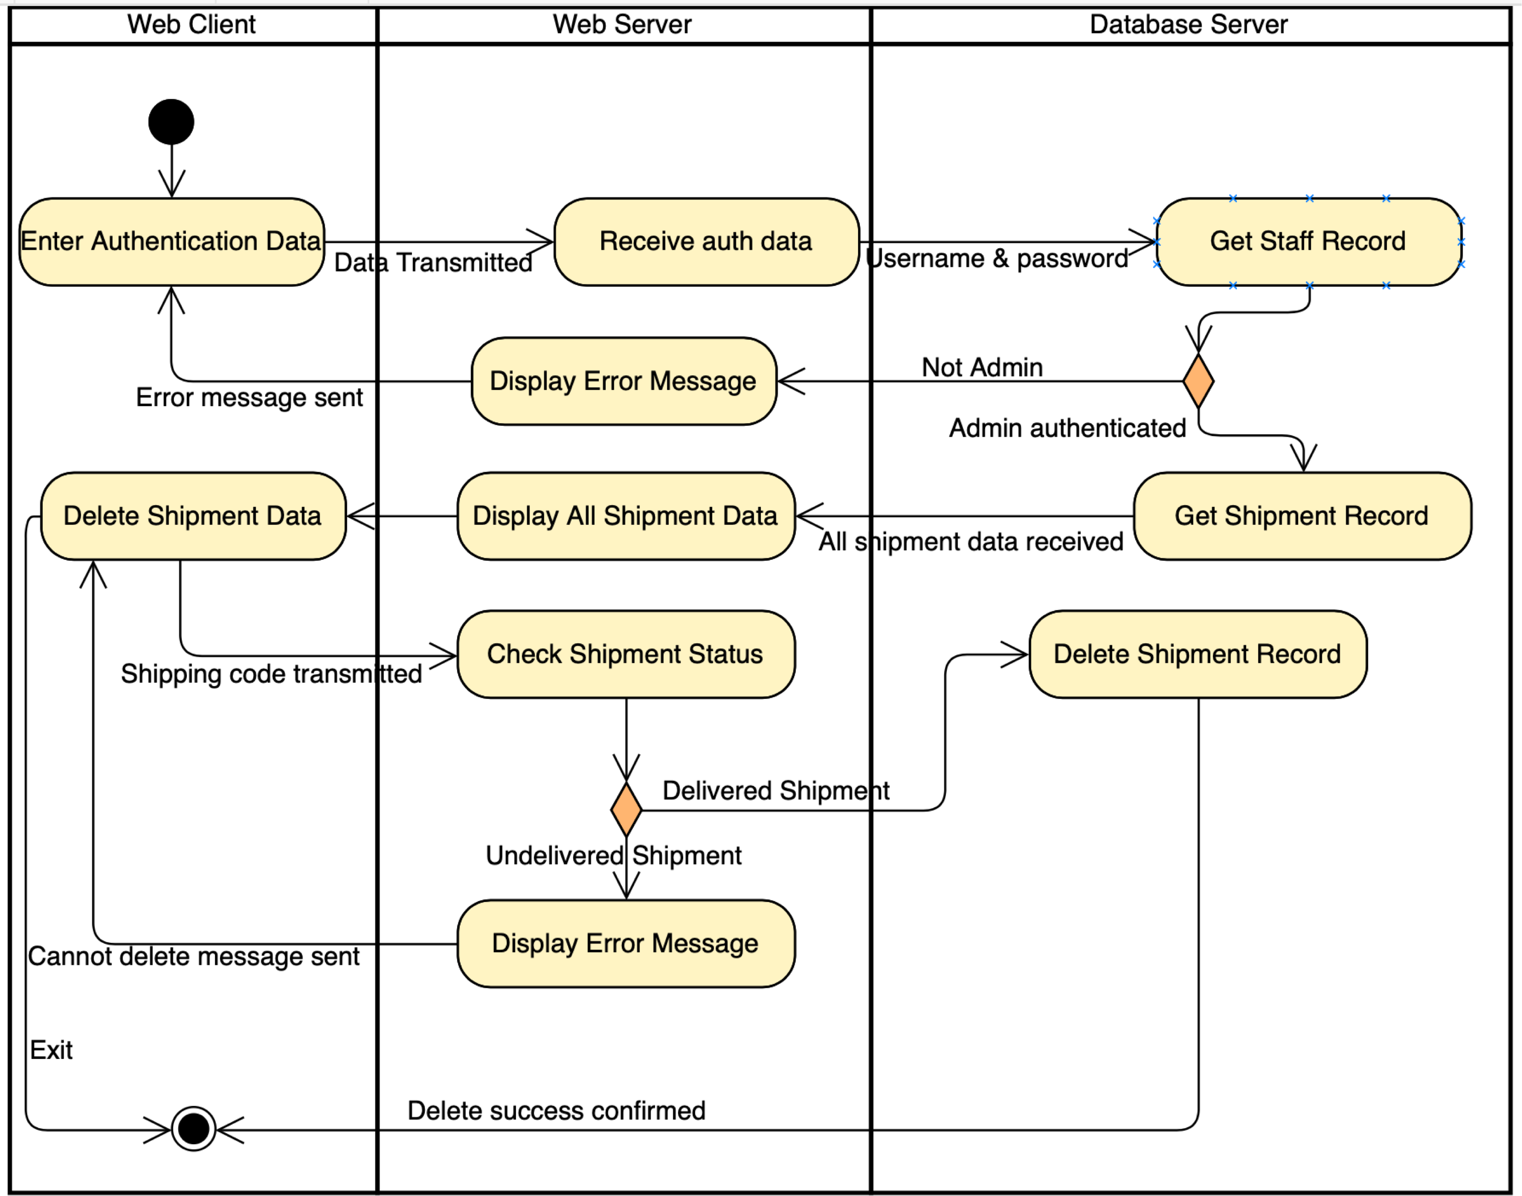
View
All Shipment

Slide 7
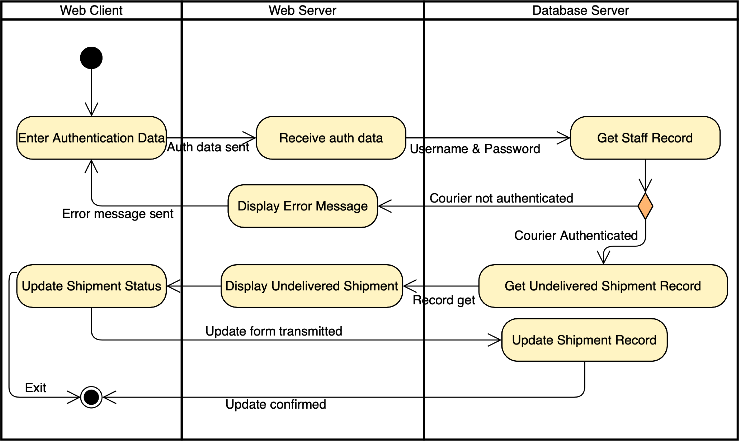
Update Shipment Status

Slide 8
Use Case Diagram
Each use case may create one activity
diagram
Use case scenarios may be generated from the use case diagram
Use Case Scenario
Use case and sequence diagram help determine classes
Activity Diagram
Each scenario may create one sequence diagram
Class Diagram
Sequence Diagram
Communication Diagram
Sequence and communication diagrams are interchangeable
Statechart Diagram
Each class may have a statechart diagram to help determine operations

Slide 9
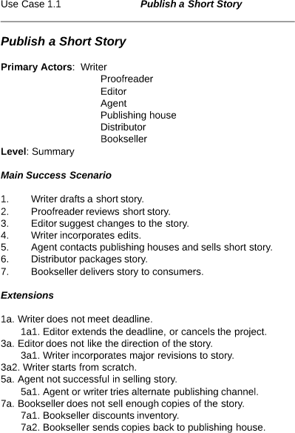

Slide 10
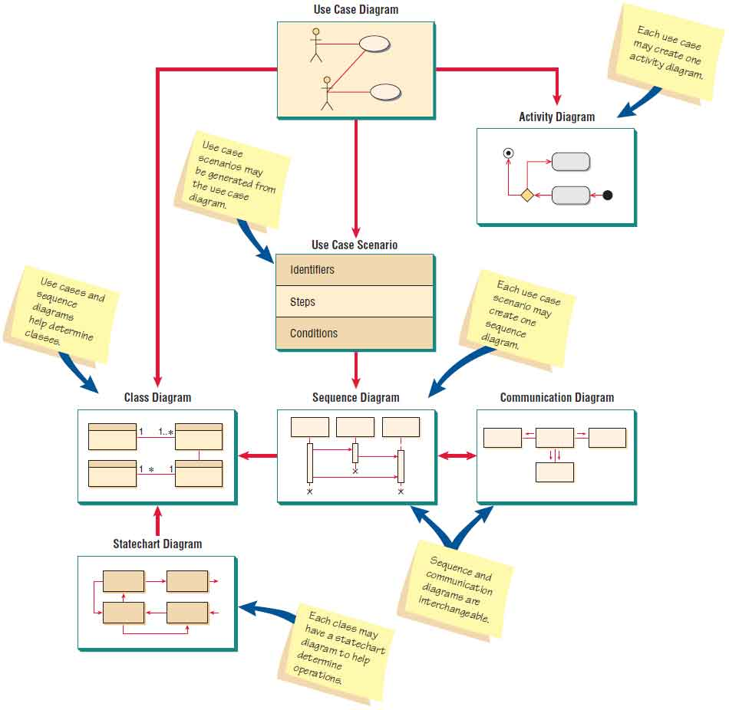

Slide 11
Use Case Diagram
Shows a view of the system from the user perspective.
Describes what a system does without describing how
the system does it.

Slide 12
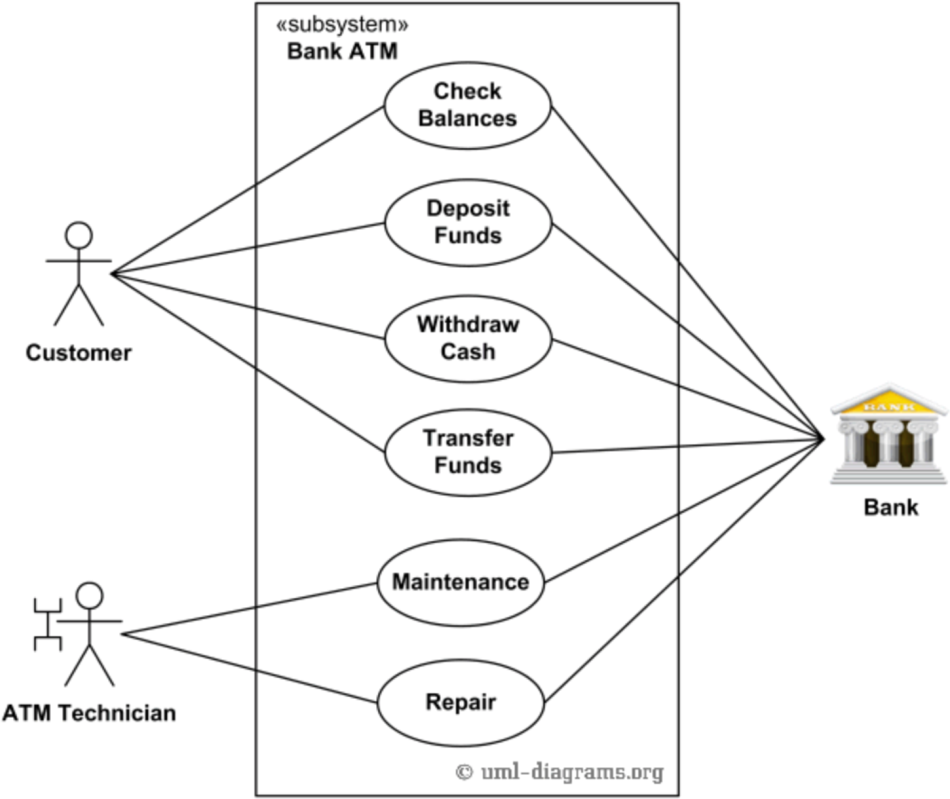
An example of use case diagram for Bank ATM Subsystem
– top level use cases

Slide 13
Activity Diagram
Shows the sequence of activities in a process, including sequential and parallel activities and also decisions that are made.
One activity diagram is usually based on one use case scenario.
Can also be derived from a DFD.

Slide 14


Activity Diagram
Swimlane A
Begin
Swimlane B
Activity
Data or events
Fork
Branch
[condition]
[else]
Activity
Activity
Activity
Merge
Join
End

Slide 15
Client Web Page
Server Web Page
Mainframe
Receive Web Form
User ID & Password
Get Student Record
Form Transmitted
Logon System
Display Error Message
Not Found
Send Error Message
Web Form Sent
Display Current Student Data
Exchange data placed in message queue
Enter Changes
Web Form Received
Validate Changes
Validation Status
Valid Data Received
Valid Data
Valid Data
Create change Student Journal Record
Record Written
Send Error Messages
Display Error Message
Update Student Record
Record Updated
Cancel
Invalid Data Received
Display Confirmation
Cancel
Confirmation
Valid Update
Sent

Slide 16
More on Activity Diagram
Not all use cases need to be described using activity diagrams.
Use it when:
It helps to understand the activities of a use case
The flow of control is complex
There is a need to model workflow
All scenarios need to be shown

Slide 17
Sequence Diagram
A form of UML interaction diagrams (the other one is called the communication diagram).
Illustrates the processing described in use case scenarios.
Used in systems design to derive the interactions, relationships, and methods of the objects exist in the system.

Slide 18


Sequence Diagram
::Class
Object::Class
method(parameter)
return
asynchronousSignal()
Or does not expect any return.
X
X

Slide 19



::newStudentU serInterface
::Student
::dorm
::program
initialize()
return studentNumber
selectDorm() return dormRoom
X
selectProgram()
return programAdvisor
studentComplete()
X
X
X

Slide 20
Class Diagram
OO methodologies work to discover classes,
attributes, methods, and relationships between classes, thus, one of the most important object- oriented analysis tasks is to define the classes.
Class diagrams show the static features of the system and also the relationships between classes, however, do not represent any particular processing.

Slide 21





Class Diagram
Department
-departmentName -departmentChair
+addDepartment() +viewDepartment()
Course
Textbook
1
1 … *
-courseNumber
-courseDescription
-numberOfCredits
-departmentNumber
-ISBN
-author
-title
-edition
-publisher
-required
has a
is for a
+addCourse()
+changeCourse()
+findCourse()
+addText()
+changeText()
+findText()
+removeText()
is a part of
 | consist of
Assignment
-assignmentNumber -assignmentDesc -assignmentPoints
-assignmentDueDate
+addAssignment() +changeAssignment()
+viewAssignment()
Exam
-examNumber -examName -examPoints -examVersion
+addExam() +changeExam() +findExam()

Slide 22
Class Diagram
4 types of classes:
Entity class – represents real-world items
Boundary or interface classes – provide a
means for users to work with the system
Abstract classes – cannot be directly instantiated,
linked to concrete classes in a generalization/specification relationships
Control classes – used to control the flow of
activities. Useful to create reusable classes.

Slide 23
Enhanced Class Diagrams
Associations
Whole/part relationships
Generalization/specialization diagrams

Slide 24


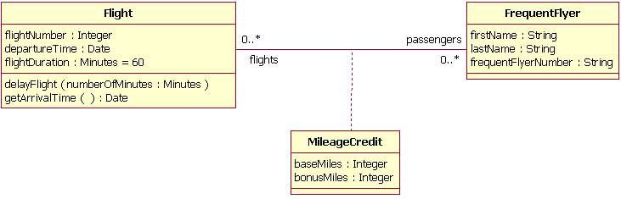
Associations
Course
Textbook
1
1 … *
-courseNumber
-courseDescription
-numberOfCredits
-departmentNumber
-ISBN
-author
-title
-edition
-publisher
-required
+addCourse()
+changeCourse()
+findCourse()
+addText()
+changeText()
+findText()
+removeText()

Slide 25



Whole/part
Department
-departmentName -departmentChair
+addDepartment() +viewDepartment()
 | Course
has a | -courseNumber -courseDescription -numberOfCredits -departmentNumber
is for a
 | +addCourse() +changeCourse() +findCourse()
is a part of
 | consist of
Assignment
-assignmentNumber -assignmentDesc -assignmentPoints -assignmentDueDate
+addAssignment() +changeAssignment() +viewAssignment()
Exam

Slide 26

Generalization / Specification
Person
-lastName -firstName
+changeName()
can be a
can be a
is a
is a
Student
Employee
-employeeNumber -salary
+changeSalary() +findEmployee()

